Slide 1

Top Tax Planning Opportunities for 2020
December 9, 2020

Slide 2
Income Tax Planning
Accelerate income and defer deductions or defer income and accelerate deductions?
  Opportunity Zone Planning
  Installment Sale
  Capital Purchases
  Accounting Method Change

Slide 3
Income Tax Planning
CARES Act Related Issues
  PPP Tax Deductibility
  Employee Retention Credit
  Employer Payroll Tax Deferral
Capital Gain/Loss Harvesting
  Uncertain Tax Rates and Market Volatility
ROTH Conversions
  Higher future tax rates and lower current values
  Re-characterization not allowed

Slide 4
Estate Planning
Estate Planning
  Using current estate/gift tax exclusion
    Spousal Lifetime Access Trust
  Take advantage of valuation discounts with closely-held business interests
  Low interest rate strategies
    GRATs
    IDGTs
    CLATs

Slide 5
Business Tax Planning
Net Operating Loss Planning
  Generate NOL in 2020 to carryback to 2015
  Accelerate deductions/defer income
Pass-through Entity Election for Louisiana
  State income tax deduction limitation
  $10,000 limit can be avoided in certain circumstances

Slide 6
Charitable Giving
Cash, appreciated securities and privately held business interests
CARES Act Provisions
  $300 above-the-line deduction
  100% of AGI Limit
  QCDs
  Carryforward rules

Slide 7
Tax Credit Planning
Transferable credits
  Lower volume of transferable credits – need to look for other avenues to minimize state tax liability and maximize and leverage use of you money.

Slide 8
Planning Dynamics: 2020 and Beyond
December 9, 2020
Schreiber & Schreiber
Certified Public Accountants

Slide 9

Jerry Schreiber
Partner with Schreiber & Schreiber
Author, “Documenting a Casualty Loss”, Journal of Accountancy, November 2008 http://www.journalofaccountancy.com/Issues/2008/Nov/Documenting+a+Casualty+Loss.htm
Presentations include Hurricanes Katrina, Rita, Wilma, Gustav, Ike, Isaac, Irene, Sandy, Matthew, Harvey, Maria, Irma, Florence, Michael, Laura, Sally, and Delta, the 2010 Nashville TN flooding, 2012 Colorado Springs Fires, 2014 Oklahoma Tornadoes, South Carolina 2015 Flooding, Spring 2016 Louisiana Flooding, August 2016 Louisiana Flooding, and 2020 California Fires.
Member, AICPA Tax Executive Committee
Author, "An Overview of AICPA and IRS Rules of Practice”, The Tax Adviser, February 2014
Author, “Tax Practice Quality Control”, The Tax Adviser, November 2012
Author, "Circular 230 Best Practices”, The Tax Adviser, April 2010
Author, “Strengthening Tax Services' Foundation”, Journal of Accountancy, May 2009
Contact at: ghschreiber@bellsouth.net, Phone 504-832-1819
Schreiber & Schreiber
Certified Public Accountants

Slide 10
Contact Info
Jerry Schreiber
ghschreiber@bellsouth.net
504-832-1819
Schreiber & Schreiber
Certified Public Accountants

Slide 11
Planning Considerations
Planning is a continuous process!
No one knows what tomorrow brings!
No set rules - a lot to think about!
Schreiber & Schreiber
Certified Public Accountants

Slide 12
We will devote a lot of time and energy for tax planning due to new Administration in DC.
We have to look at all the other parts of the equation!
Schreiber & Schreiber
Certified Public Accountants

Slide 13
The Whole Team Has To Be Involved
Planning Dynamics are Changing
Legal
Tax
Insurance
Investments
Charitable
Schreiber & Schreiber
Certified Public Accountants

Slide 14
Planning Considerations
Forget Territorial Boundaries!
We have one goal - to serve the client
Legal
Estate and Gift
Tax
Investments
Insurance
Charity
Schreiber & Schreiber
Certified Public Accountants

Slide 15
The whole team has to be involved in the planning process!
“Luck is when opportunity meets proper planning!”
No territorial distinctions!
Schreiber & Schreiber
Certified Public Accountants

Slide 16
Legal
Just because I/We have a will, trust, insurance, and other things in place does not mean it will be applicable today.
We have to update for the most recent circumstances and plan accordingly.
Schreiber & Schreiber
Certified Public Accountants

Slide 17
Tax Planning
Schreiber & Schreiber
Certified Public Accountants

Slide 18
Investments
Do you consider the need of cash/liquidity for an extended period of time?
  Cash is King!
Pandemic-part of planning going forward? When will this end?
Natural disaster-considerations for those living in certain areas?
Does the financial planning module change for these considerations?
How much liquidity is needed?
Schreiber & Schreiber
Certified Public Accountants

Slide 19
Insurance
Business and personal
Who has/had pandemic insurance?
Assessing risk!
Deductibles?
More self insurance?
Cost v. benefit relationship
Supplemental Flood?
Create entities for holding certain assets because of liability?
Schreiber & Schreiber
Certified Public Accountants

Slide 20
Charity
We have clients with substantial assets-much more than they will need for their lifetimes
There are a lot in need due to circumstances in general without the pandemic
Our clients can do a lot of good with what they have to provide for those in need
Schreiber & Schreiber
Certified Public Accountants

Slide 21
TCJA
(Modification of deduction for taxes not paid or accrued in a trade or business (sec. 1303 of the House bill, sec. 11042 of the Senate amendment, and sec. 164 of the Code))
Schreiber & Schreiber
Certified Public Accountants

Slide 22
The provision contains an exception to the above-stated rule. Under the provision a taxpayer may claim an itemized deduction of up to $10,000 ($5,000 for married taxpayer filing a separate return) for the aggregate of (i) State and local property taxes not paid or accrued in carrying on a trade or business, or an activity described in section 212, and (ii) State and local income, war profits, and excess profits taxes (or sales taxes in lieu of income, etc. taxes) paid or accrued in the taxable year. Foreign real property taxes may not be deducted under this exception.
The above rules apply to taxable years beginning after December 31, 2017, and beginning before January 1, 2026.
Schreiber & Schreiber
Certified Public Accountants

Slide 23
Notice 2019-12 https://www.irs.gov/pub/irs-drop/n-19-12.pdf
Schreiber & Schreiber
Certified Public Accountants

Slide 24
SECTION 3. SAFE HARBOR FOR INDIVIDUALS
Under this safe harbor, an individual who itemizes deductions and who makes a payment to a section 170(c) entity in return for a state or local tax credit may treat as a payment of state or local tax for purposes of section 164 the portion of such payment for which a charitable contribution deduction under section 170 is or will be disallowed under final regulations.
Schreiber & Schreiber
Certified Public Accountants

Slide 25
Example 1
In year 1, Taxpayer A makes a payment of $500 to an entity described in section 170(c). In return for the payment, A receives a dollar-for-dollar state income tax credit. Prior to application of the credit, A’s state income tax liability for year 1 was $500 or more; A applies the $500 credit to A’s year 1 state income tax liability. Under section 3 of this notice, A treats the $500 payment as a payment of state income tax in year 1 for purposes of section 164. To determine A’s deduction amount, A must apply the provisions of section 164 applicable to payments of state and local taxes, including the limitation under section 164(b)(6).
Schreiber & Schreiber
Certified Public Accountants

Slide 26
Example 2
In year 1, Taxpayer B makes a payment of $7,000 to an entity described in section 170(c). In return for the payment, B receives a dollar-for-dollar state income tax credit, which under state law may be carried forward for three taxable years. Prior to application of the credit, B’s state income tax liability for year 1 was $5,000; B applies $5,000 of the $7,000 credit to B’s year 1 state income tax liability. Under section 3 of this notice, B treats $5,000 of the $7,000 payment as a payment of state income tax in year 1 for purposes of section 164. Prior to application of the remaining credit, B’s state income tax liability for year 2 exceeds $2,000; B applies excess credit of $2,000 to B’s year 2 state income tax liability. For year 2, B treats the $2,000 as a payment of state income tax for purposes of section 164. To determine B’s deduction amounts in years 1 and 2, B must apply the provisions of section 164 applicable to payments of state and local taxes, including the limitation under section 164(b)(6).
Schreiber & Schreiber
Certified Public Accountants

Slide 27
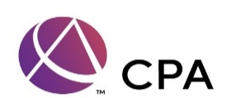
Example 3
In year 1, Taxpayer C makes a payment of $7,000 to an entity described in section 170(c). In return for the payment, C receives a local real property tax credit equal to 25 percent of the amount of this payment ($1,750). Prior to application of the credit, C’s local real property tax liability in year 1 was $3,500; C applies the $1,750 credit to C’s year 1 local real property tax liability. Under section 3 of this notice, for year 1, C treats $1,750 as a payment of local real property tax for purposes of section 164. To determine C’s deduction amount, C must apply the provisions of section 164 applicable to payments of state and local taxes, including the limitation under section 164(b)(6).
Schreiber & Schreiber
Certified Public Accountants
Schreiber & Schreiber
Certified Public Accountants

Slide 28
Louisiana Tuition Donation
Rebate Program
Schreiber & Schreiber
Certified Public Accountants

Slide 29
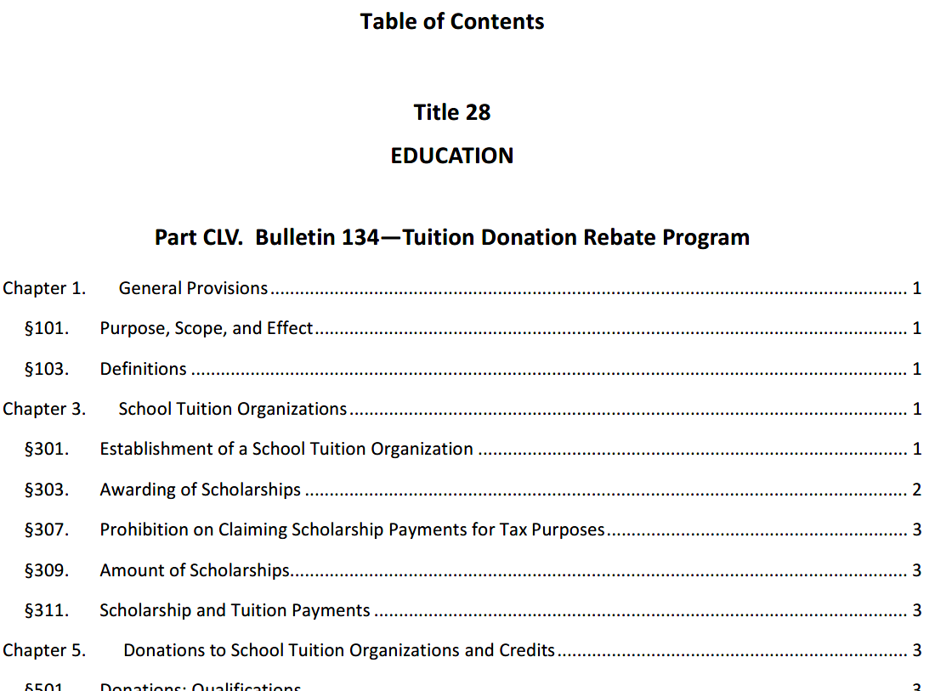
Schreiber & Schreiber
Certified Public Accountants

Slide 30
Tuition Deduction/Credit Program
Income Level | Benefits/Detriments
Middle and Modest Income | Charitable deduction would be reduced Still get increased standard deduction/exemption if not able to itemize
Higher Income | Charitable deduction would be reduced Does not enter into $10,000 limit for state income and real estate tax Planning to be sure taxpayer is over the limit for increased standard deduction/exemption to be able to itemize
Schreiber & Schreiber
Certified Public Accountants

Slide 31
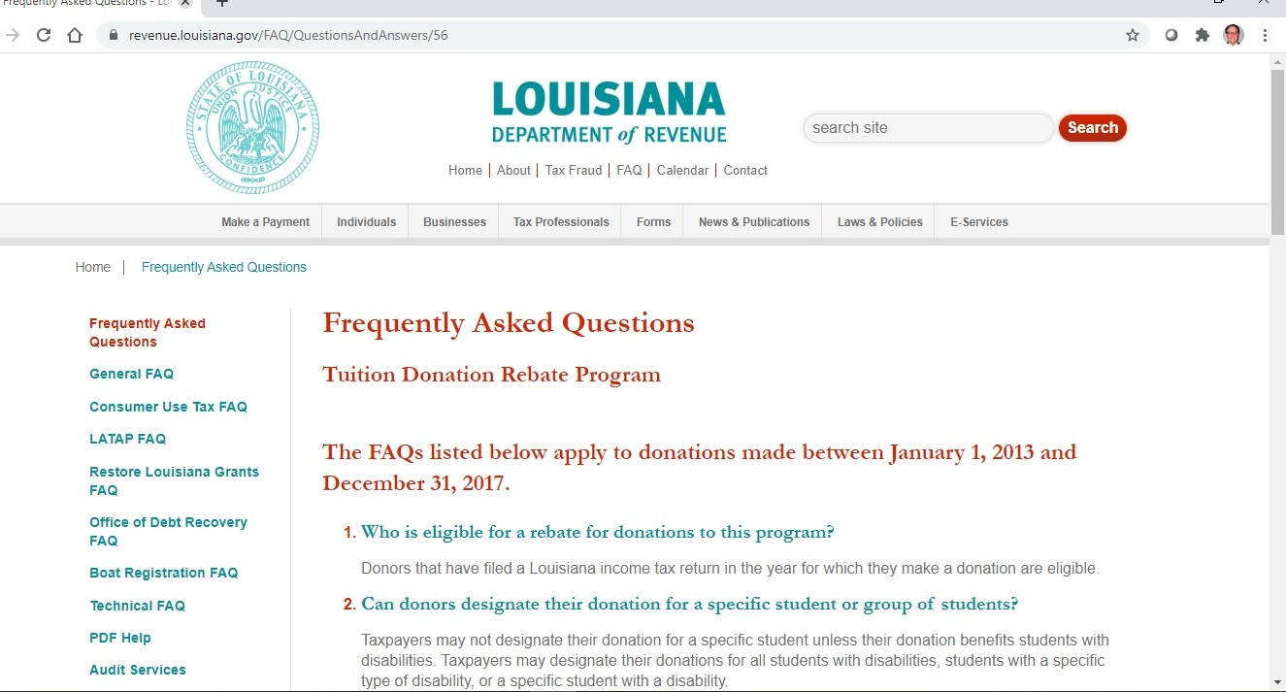
Schreiber & Schreiber
Certified Public Accountants

Slide 32
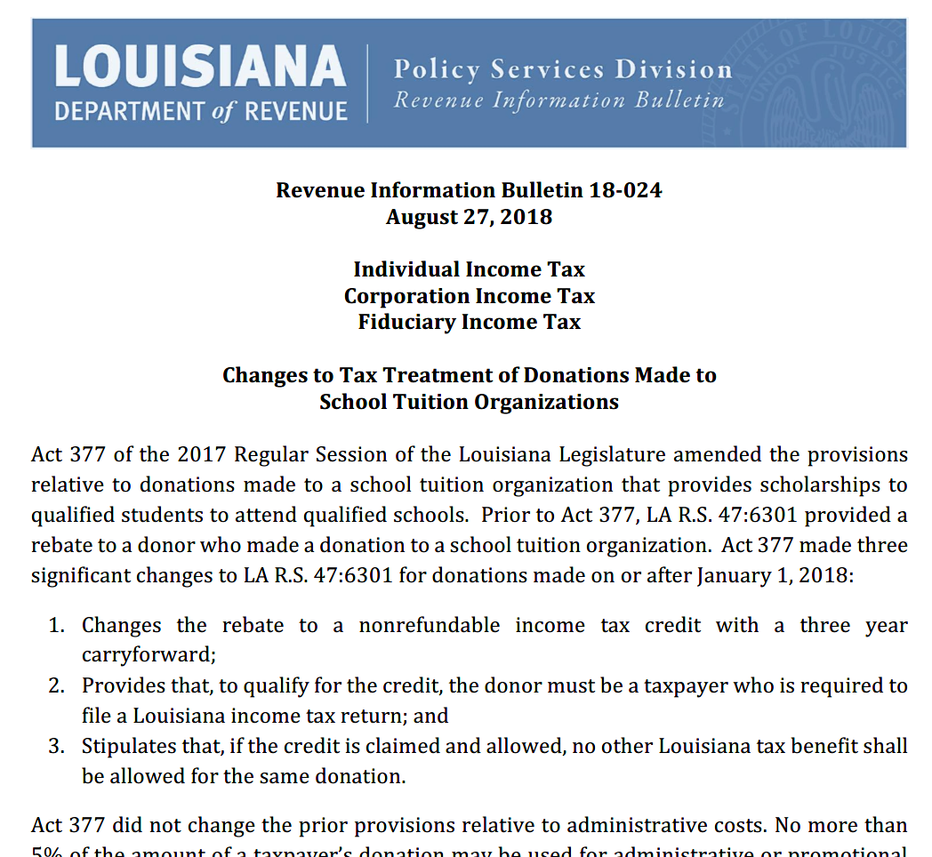
Schreiber & Schreiber
Certified Public Accountants

Slide 33
Individual Example
On June 1, 2018, Michael Smith makes a $1,000 donation to a school tuition organization. On 2018 Federal Form 1040, Mr. Smith claims itemized deductions on Federal Schedule A in the amount of $15,800. Mr. Smith’s standard deduction would have been $12,000. Of the $15,800 of itemized deductions, $1,000 consisted of the donation to the school tuition organization. On 2018 LA Form IT-540, Mr. Smith claims the excess federal itemized personal deduction in the amount of $3,800 ($15,800 – $12,000).
On July 15, 2018, LDE issues a receipt through the school tuition organization to Mr. Smith indicating that $950 of his donation was used by the school tuition organization to fund qualified scholarships. The remaining $50 was applied toward administrative costs.
Schreiber & Schreiber
Certified Public Accountants

Slide 34
Individual Example-Continued
Therefore, Mr. Smith may only claim a $950 nonrefundable credit on his 2018 LA Form IT-540 ($1,000 donation less $50 of administrative costs).
To satisfy the provisions of LA R.S. 47:6301(A)(1)(a), Mr. Smith must add back $950 to arrive at Louisiana Adjusted Gross Income on Schedule E of the 2018 LA Form IT-540.
Assume Mr. Smith’s tax liability is $500. Mr. Smith may only claim a $500 credit in 2018 and carryforward the remaining $450 to 2019, 2020, and 2021 as applicable. In this example, Mr. Smith need only add back $500 on the 2018 LA Schedule E which is the amount of the credit claimed as well as the amount of the tax liability.
Schreiber & Schreiber
Certified Public Accountants

Slide 35

Individual Example-Continued
Schreiber & Schreiber
Certified Public Accountants

Slide 36
Corporate Example
In the year the corporation claims the credit, the corporation shall make an addition on Schedule F of the LA Form CIFT-620 if the following condition applies:
1. The corporation’s federal deductions for charitable contributions allowed by Internal Revenue Code Section 170 included a deduction for the donation made by the corporation to the school tuition organization.
The addition required to be made on Schedule F of the LA Form CIFT-620 shall be the amount of the charitable contribution claimed on the corporation’s federal return. The addition is limited to the amount of the credit claimed on the return.
Schreiber & Schreiber
Certified Public Accountants

Slide 37
Tax Dollars for Young Scholars: The Tuition Donation Credit
Arthur Dupre
President, ACE Scholarships Louisiana

Slide 38
Background of TDC: National Context
    Nationally, there are around 22 tax credit scholarship programs across 18 states. First one created in 1997.
    Proven to be successful models for giving all children and families greater access to high-quality schools. Incentivizes businesses and individuals to get involved in education reform.
    $1.3 billion expended across America last year on tax credit scholarships for over 330,000 children that have special needs, that are victims of bullying, and that hail from financially-struggling families
    On average, American taxpayers spend $15,424 per student nationwide on K-12 public education. Average tax credit scholarship, which provides access to the elementary school or high school of the parent/guardian’s choice is less than half of that ($4,350 in Louisiana).

Slide 39
Background of TDC: The Rationale
Louisiana perpetually ranks dead last or near last in most metrics, including education and poverty
Louisiana has a 26.5% state child poverty rate, the nation’s second highest
One of the lowest high school graduation rates (78%), lowest ACT/college readiness scores, math and reading proficiency scores
Some of the highest rates of bullying and threats of injury/violence in schools
Question became: how can we help all boats (and all children) rise?

Slide 40
Background of TDC: Legislative
    2012 Legislative Session: Tuition Donation Rebate program (HB 969 [Talbot] ; ACT 25 )
      Rebate
      Growth
      Issues
    2017 Legislative Session: Tuition Donation Credit program (SB 95 [Morrish]; ACT 377)
      What prompted the change?
      What changed about the program, particularly for donors?
        Credit vs rebate
        Must be required to file a LA tax return (effectively eliminated non-profits and out-of-state, non-required filers)
        No more waiting! Earned immediately

Slide 41
Tuition Donation Credit - TDC
Who is involved in this program?
  STOs
  Students
  Schools
  Donor

Slide 42
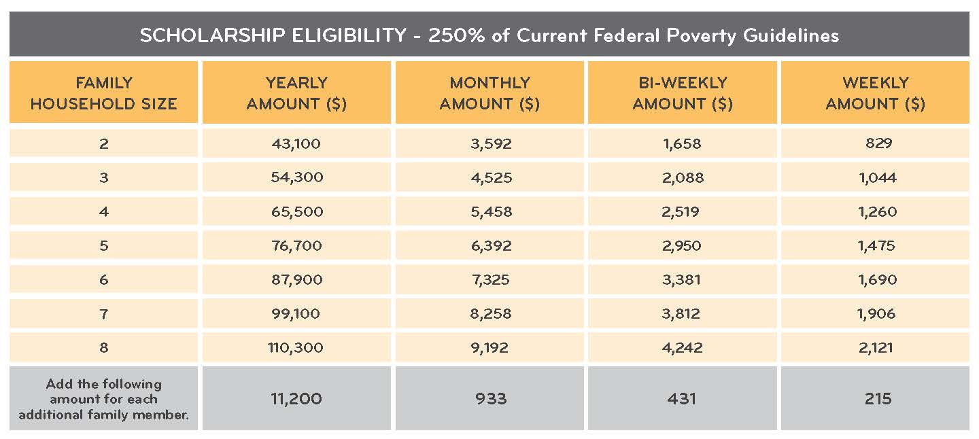
How does the TDC program work:
Students: Application and Award Process
  Families apply to STO and to schools they are interested in their child attending; awarded first-come, first-served with several priorities/tiers
  Household income may not exceed 250% of federal poverty line

Slide 43
How does the TDC program work:
Schools: Partnership and Accountability
  Over 200 Louisiana K-12 nonpublic schools participate in the TDC program
  Accredited or at least approved by Board of Elementary and Secondary Education (BESE)
  Testing and Reporting
  Accountability: 3 Metrics
    Fiscal
    Health and Safety
    Academic

Slide 44
How does the TDC program work?
Donors: Timing, General Benefit, and Things to know
  Taxpayer can eliminate 100% of state income tax liability
  Credit is earned immediately; they are not brokered/purchased and no delay in having to certify through the state
  Nonrefundable credit; can be claimed/used over a 4-year period
  Not considered income and therefore not taxable
  The credit is uncapped
    Safeguards in place to prevent STOs from sitting on cash (75% rule)
    Cost savings to the state per pupil (80% and 90% of MFP); clean fiscal note
  Credit applies to the tax year in which the donation is made; not retroactive

Slide 45
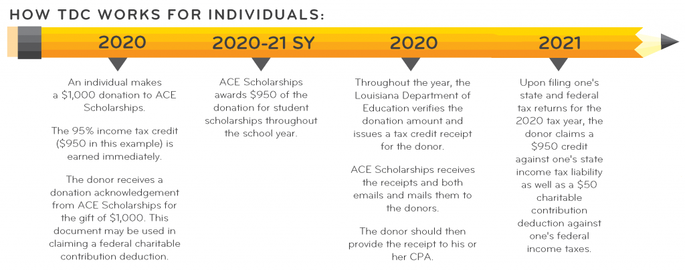

Slide 46
Ways to Give
Standard cash gift
Appreciated Assets
Qualified Charitable Distributions (QCDs) from IRAs
Donor Advised Fund or family foundation for non-itemizers for an additional cost savings
  Example: Client has a Louisiana income tax liability of $20,000
    Client donates $20,000 to STO; receives a 100%, dollar-for-dollar credit
    Client makes a separate donation of $1,000 from DAF to cover 5% administrative fee
    Client claims the standard deduction; because the client does not itemize, client would not have been able to receive the partial federal deduction
    By covering 5% from DAF, client receives full state benefit of 100% credit and was able to save an additional $400+

Slide 47
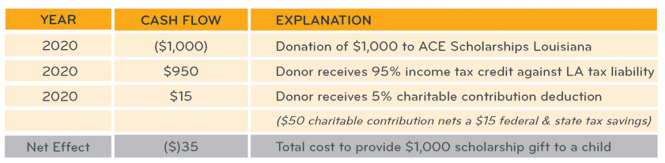
Tax Benefit by Entity: Individuals
  Itemizing (3%) vs non-itemizing (5%)

Slide 48
Tax Benefit by Entity: Businesses
Businesses
  Pass-throughs, privately held S-corporations
  C-corporations
Others
  Non-profits
  Trusts/Estates
  1120-PC

Slide 49
Individual vs Corporate Timelines
Individual
  Donation made within calendar year
  Individuals may deduct charitable contributions as an itemized deduction on Federal Schedule A
Corporate
  Donation made within company’s fiscal year
  C-corporations may fully deduct donation as a necessary and ordinary business expense on federal return
  Specified S-corporations may fully deduct donation as a necessary and ordinary business expense on federal return

Slide 50
Where the TDC Stands Now: Federal
2018: IRS proposes regulations
2020: IRS issues finalized regulations on August 11, 2020
  How does the IRS define a specified passthrough entity?
  What constitutes a “necessary and ordinary business expense?”
  How does this work? If my client makes a donation through the Tuition Donation Credit program, the client receives a state income tax credit at 95% and a full federal deduction? Is it deductible as a charitable contribution under Section 170 or as a business expense under Section 162?
  How does this affect shareholders individual liabilities and returns?

Slide 51
Safe Harbor
C-corporations
  receive full state benefit of tax credit and full federal deductibility
  consider the benefit to C-corps vs other credit programs
S-corporations

Slide 52
  Where the TDC Stands Now: State
LDR: Revenue Information Bulletin 18-024
LDE: Bulletin 134
Unchanged on state level

Slide 53
Receipts and Forms
Donation Acknowledgement from ACE
Tax Credit Receipt (Form R-10640); received from LDE/STO
Individuals: IT-540, IT-540(B)
Corporations: CIFT-620
Fiduciary (Trusts and Estates): IT-541

Slide 56
Miscellaneous Questions
Does ACE or other STOs choose the kids or do I?
These scholarships are for college too?
Does my donation need to be spent for me to claim the credit?
How does this affect public schools?

Slide 57
  Tuition Donation Credit
To claim the tuition donation credit, any donation needs to be made by December 31st at 11:59pm
Please reach out with any questions about the TDC or how to take advantage of it
  adupre@acescholarships.org
  (504) 710-1132

Slide 58

  To learn more visit acescholarships.org
  For questions, please contact Arthur Dupre: adupre@acescholarships.org, (504) 710-1132

